Slide 1
DATA ANALYTICS
BOOK RECOMMENDATION SYSTEM
PRESENTED BY:
ANSHIKA PAL - PES1UG20CS062
ROHAN - PES1UG20CS346
CHANNABASAVANNA HATTI - PES1UG20CS110

Slide 2
ABSTRACT!
Need and significance of the problem

Slide 3
ABSTRACT
The main objective is to create a book recommendation system for users. Recommender systems are really critical in some industries as they can generate a huge amount of income when they are efficient or also be a way to stand out significantly from competitors. Collaborative Filltering, Content-Based Filtering is used. And in Collaborative filtering, user-Based and Item-Based Collaborative filtering is used.
A recommendation system broadly recommends items to the user best suited to their tastes and traits. It uses the user's previous data and other user's data to give new recommendations.

Slide 4
SCOPE!
Novelty of the project opted

Slide 5
SCOPE
A book recommendation system is a type of recommendation system where we have to recommend similar books to the reader based on his interest. The books recommendation system is used by online websites which provide ebooks like google play books, open library, good Read's, etc.

Slide 6
DATASET!
Novelty of the project opted

Slide 7
DATASET
For this Project, we used Book-Crossing(BX) Dataset. This Dataset contains 278,858 users(anonimyzed but with demographic information) providing 1,149,780 ratings(explicit and implicit) about 271,379 books.
Dataset Description:
i. BX-Books.csv has 8 columns which include information about books.We can uniquely identify each book with the help of ISBN. The tile, author and publisher and year of publication of each book has been listed. The last three columns include URLs for different sizes of images.
ii. BX-Users.csv: lists the age and location of a user along with their User-ID.
iii.BX-Book-Ratings.csv: contains book ratings given by users. The User-ID and ISBN have also been provided.

Slide 8
IMPLEMENTATION DETAILS!
Novelty of the project opted

Slide 9
IMPLEMENTATION DETAILS!
1. Modules used:
pycountry_convert, wordcloud, surprise, numpy , pandas, gradio, matplotlib,missingno,seaborn.
2.Dataset Collection:
BX_book.csv
3.Model:
1.Collabrative filtering
2.Content based
3.Item Based
4.Machine Learning based
4. UI:
using Gradio.

Slide 10
PROJECT DEMONSTRATION

Slide 11
PROJECT DEMONSTRATION
For this Project, we used Book-Crossing(BX) Dataset. This Dataset contains 278,858 users(anonimyzed but with demographic information) providing 1,149,780 ratings(explicit and implicit) about 271,379 books.
Dataset Description:
.BX-Books.csv has 8 columns which include
information about books.We can uniquely identify each book with the help of ISBN. The tile, author and publisher and year of publication of each book has been listed. The last three columns include URLs for different sizes of images.
ii.BX-Users.csv: lists the age and location of a user along
with their User-ID.
iii.BX-Book-Ratings.csv: contains book ratings given by
users. The User-ID and ISBN have also been provided.

Slide 12
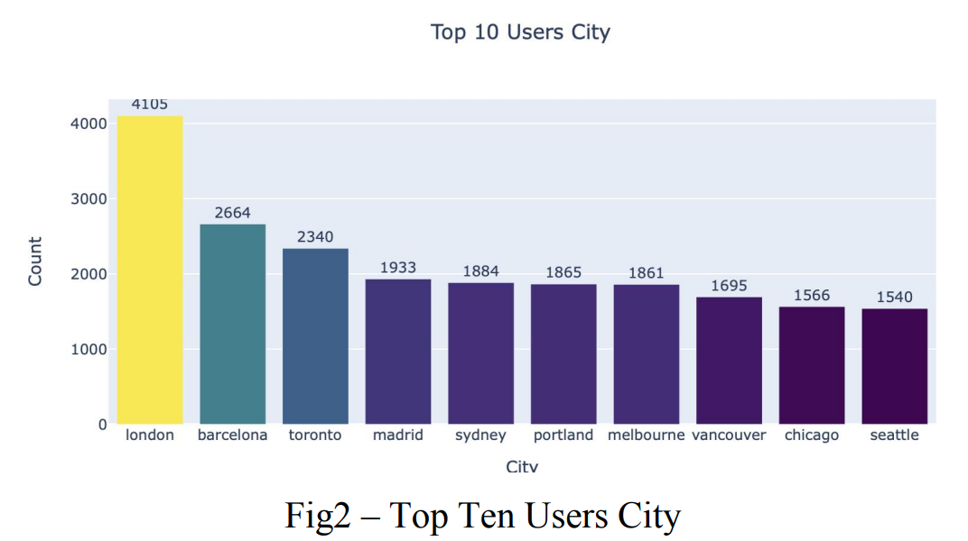
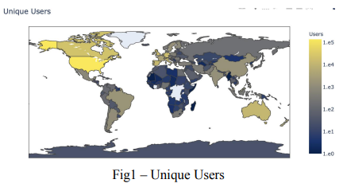
Exploratory Data Analysis

Slide 13
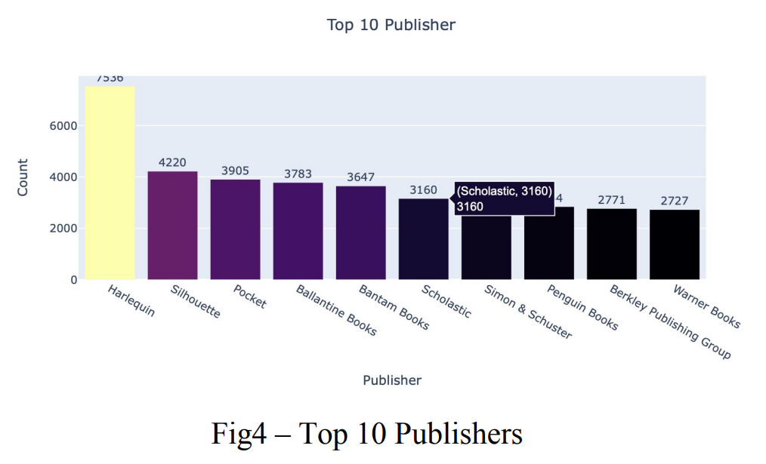
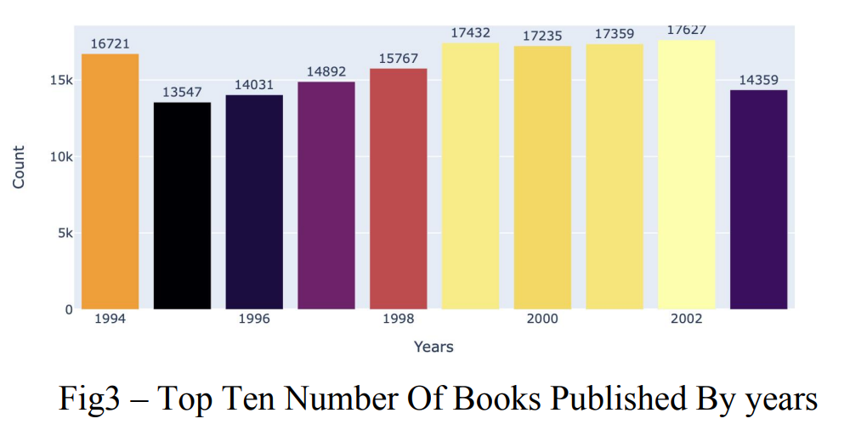
Exploratory Data Analysis

Slide 14
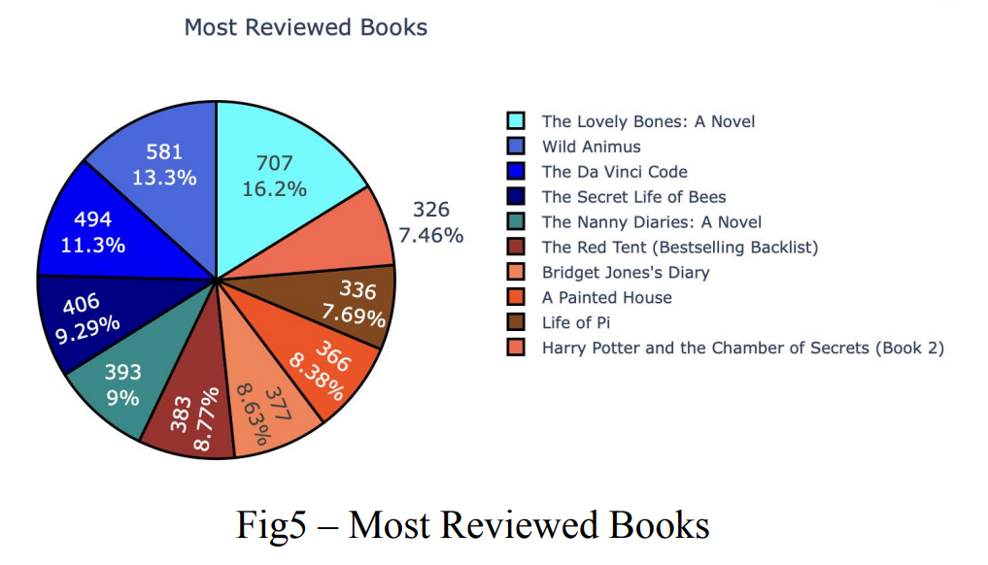
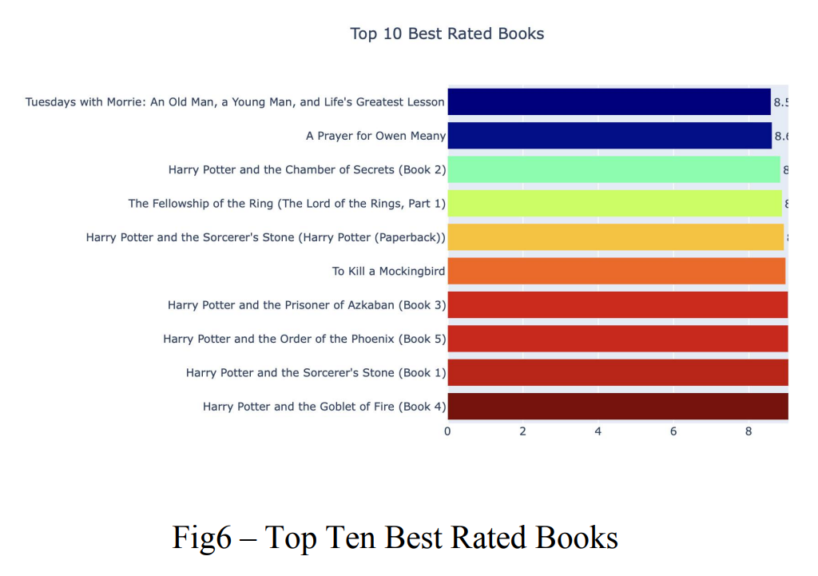
Exploratory Data Analysis

Slide 15
PROJECT DEMONSTRATION
Modules used: pycountry_convert, wordcloud, surprise, numpy , pandas, gradio, matplotlib,missingno,seaborn.
We used:
Collaborative filtering and in that user- user based and item - item based filtering.
KNN Algorithm for Collaborative-Based Filtering. Collaborative Filtering Using k-Nearest Neighbors (kNN) kNN is a machine learning algorithm to find clusters of similar users based on common book ratings, and make predictions using the average rating of top-k nearest neighbors.
By iterating the columns, we are subtracting the mean values. compute_similarity() is calculating the cosine similarity of two users. create_similarity_matrix() is creating the cosine similarity matrix between all the users. get_neighbors() is calculating the neighbours on the basis of matrix created. recommend() is recommending the top users that a user is matched with.
DRAWBACKS: Scalability and Scarcity

Slide 16
PROJECT DEMONSTRATION
2. CONTENT-BASED FILTERING :
1. Content-based filtering, also referred to as cognitive filtering, recommends items based on a comparison between the content of the items and a user profile.
2. The content of each item is represented as a set of descriptors or terms, typically the words that occur in a document
3.After cleaning and preparing the data, we can use TF- IDF representation to make our recommender system.

Slide 17
PROJECT DEMONSTRATION
3.Model Based :
1. We will limit the books in this whose ratings are given atleast 5 times. We are normalizing the ratings on the basis of gaussian normalization.
2. Baselines can be estimated in two different ways:
1. Stochastic Gradient Descent (SGD)
2. Alternating Least Squares (ALS)
* With the implementation of these models we can print the required output in our UI
* For UI we have used Gradio.

Slide 18
PROJECT DEMONSTRATION
3.Model Based :
1. We will limit the books in this whose ratings are given atleast 5 times. We are normalizing the ratings on the basis of gaussian normalization.
2. Baselines can be estimated in two different ways:
1. Stochastic Gradient Descent (SGD)
2. Alternating Least Squares (ALS)
* With the implementation of these models we can print the required output in our UI
* For UI we have used Gradio.

Slide 19
RESULT AND DISCUSSION

Slide 20
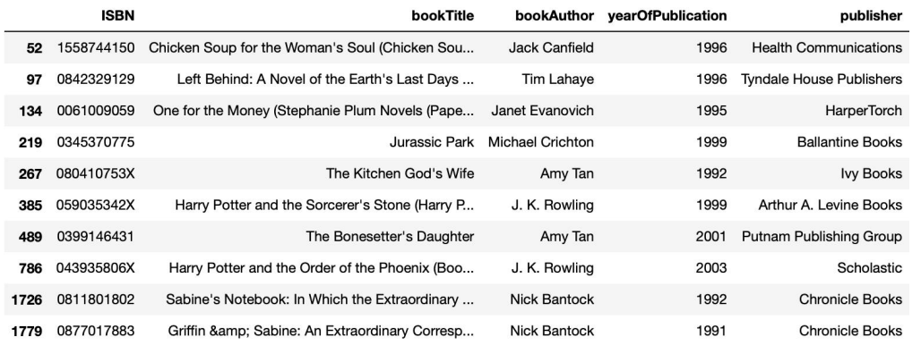
Result and Discussion
Using Collabarative filtering
User - based

Slide 21
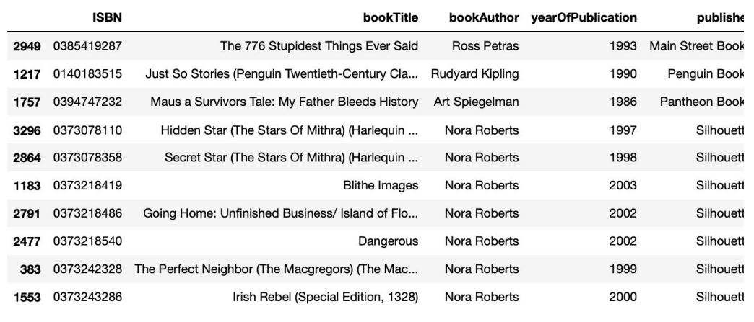
Result and Discussion
Collabarative filtering
Item-based

Slide 22
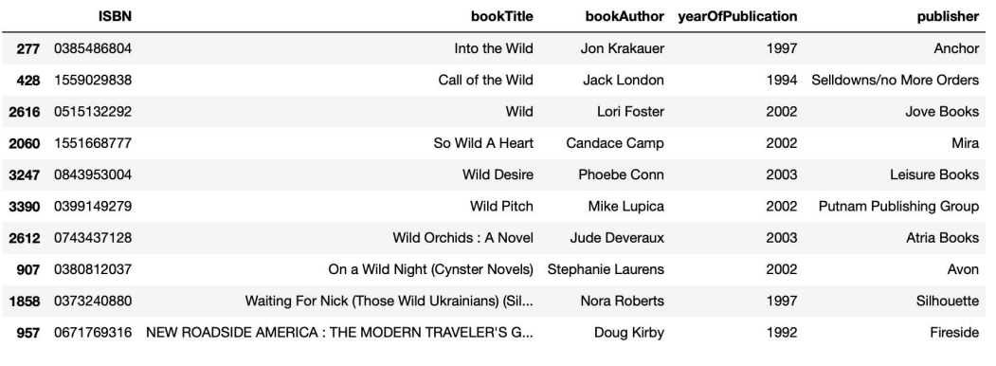
Result and Discussion
Content - based filtering

Slide 23
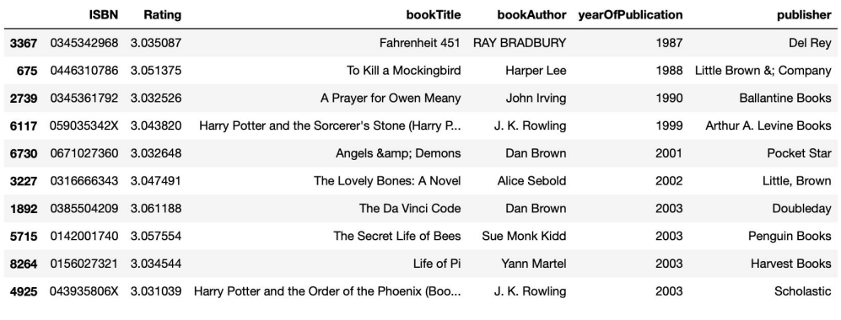
RESULT AND DISCUSSION
Using machine learning based models

Slide 24
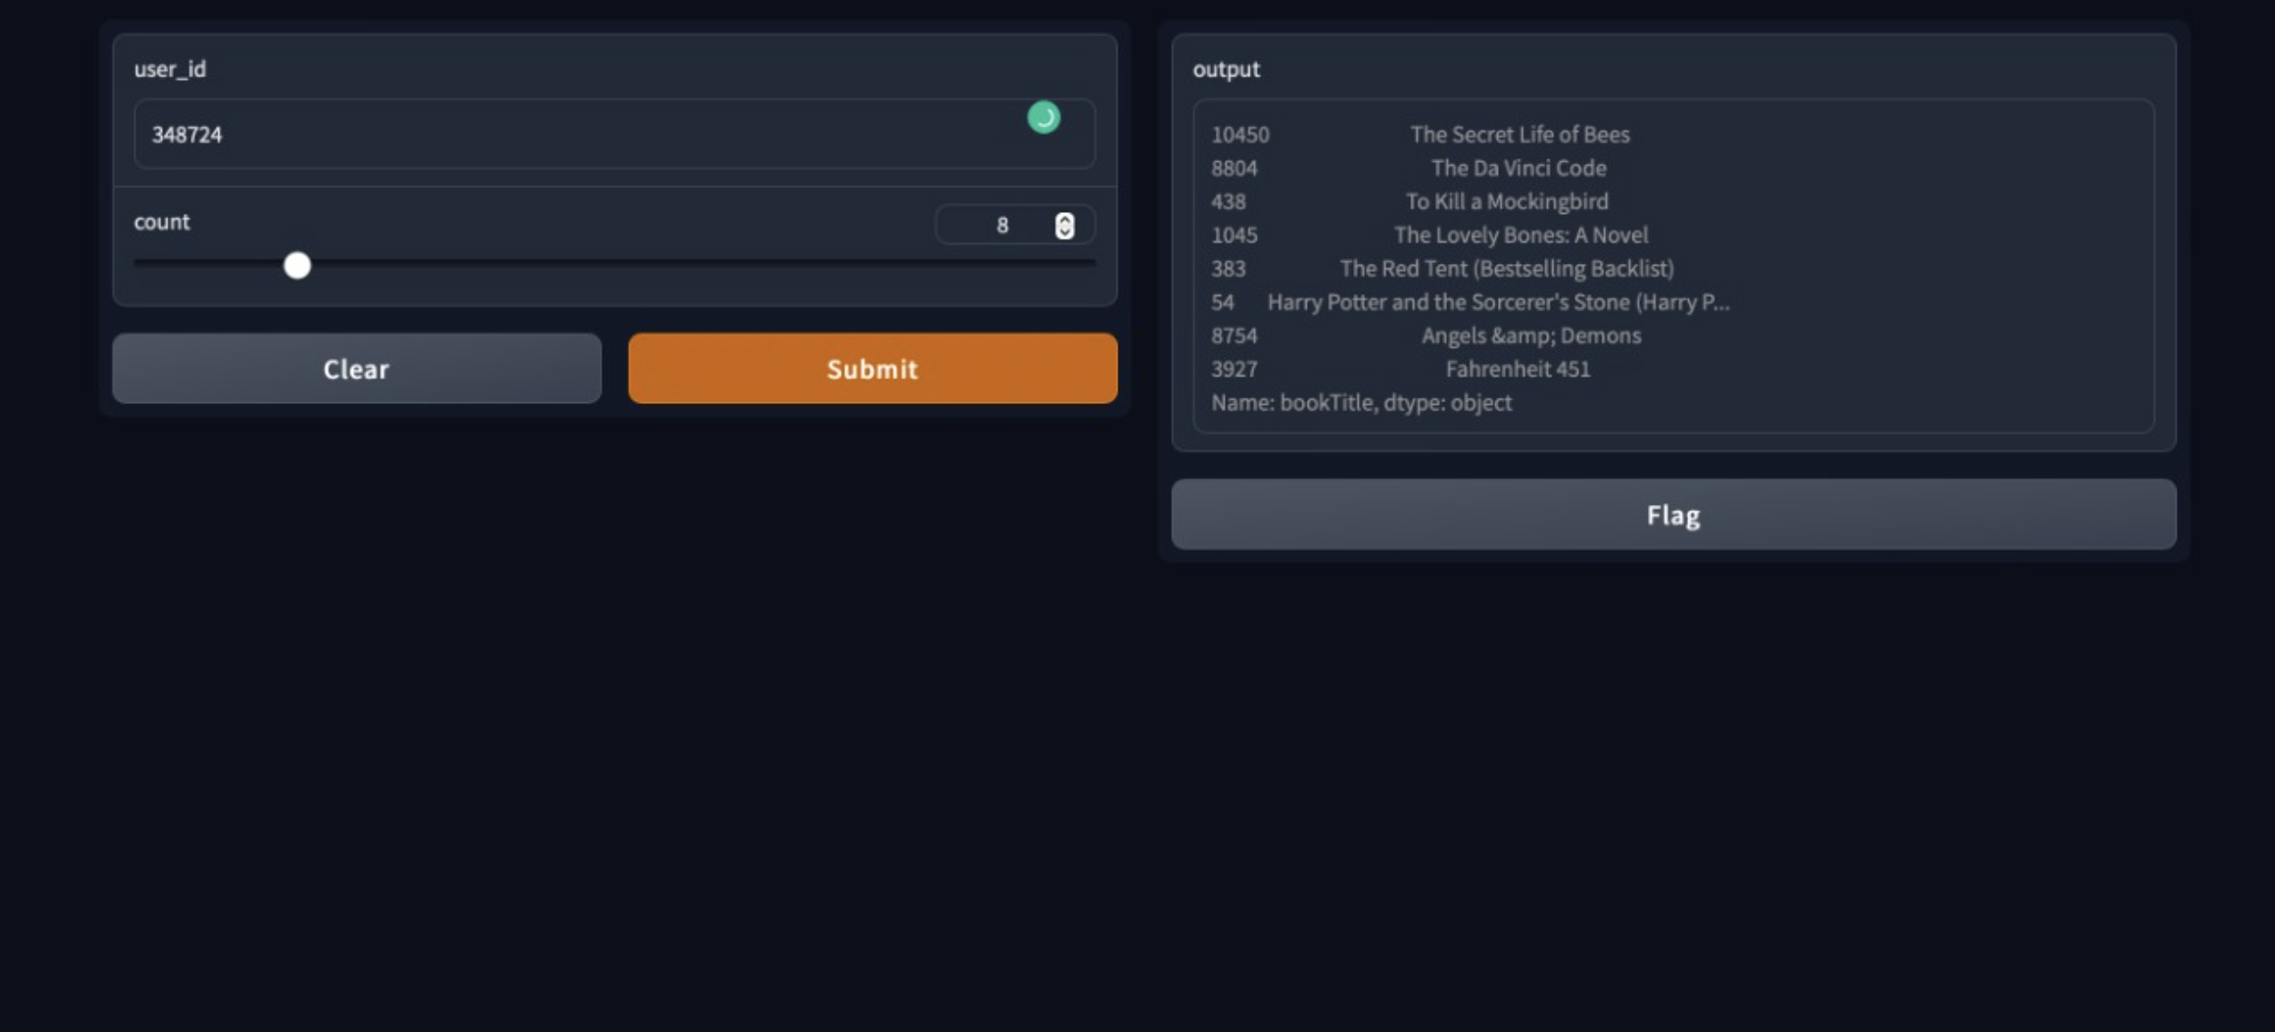
RESULT AND DISCUSSION
EXPECTED OUTPUT IN THE UI

Slide 25
FUTURE WORK

Slide 26
FUTURE WORK
We can create the hybrid model i.e. it is special type of recommendation system which can be considered as the combination of the content and collaborative filtering method. Combining collaborative and content-based filtering together may help in overcoming the shortcoming we are facing at using them separately and also can be more effective in some cases.

Slide 27
THANK YOU

